Slide 1
Tutorial 2 Creating Links

Slide 2
Objectives 2.1
Create a link to another Web site on the Internet
Create a link to download a file
Create an email link
Link to a specific section on the same page
Create a link to another Web page on the same site

Slide 3
Objectives 2.2
Use an image as a link
Create thumbnail links to larger images
Create image maps
Create rectangle, circle, and polygon hotspots

Slide 4
Communications Technology
A hyperlink is text or an image that, when clicked, displays:
another part of the same Web page
another Web page in the same site
another Web page from a different site
A protocol is a standard for sending and receiving data.
HTTP, or Hypertext Transfer Protocol, is used to access the Web.

Slide 5
Communications Technology
File servers are computers that contain or direct information.
HTTP establishes standards for communications between file servers and clients.
TCP/IP, or Transmission Control Protocol/ Internet Protocol, is used to send packets across communication lines.

Slide 6
Web Site Addresses
Every computer connected to the Internet has an IP address.
IP addresses are composed of a series of four numbers (e.g., 12.34.222.111).
The Domain Name System refers to Web sites by Web server names.
The domain name is followed by a suffix (.com, .net, .org, .edu, etc.).
A URL, or Uniform Resource Locator, is the complete address of a Web site and page.

Slide 7
Parts of a URL
URL structure: protocol://servername.domainname.suffix/path/filename http://www.cengage.com/contact
Default filename: index.htm, index.html

Slide 8
Creating Links
A Web site may have links to the following four types of destinations:
a named section on the same page
another page on the same Web site
a named section of another page on the same Web site
a page on a different Web site
A link could be text or an image.

Slide 9
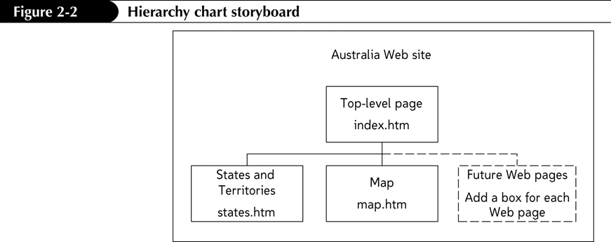
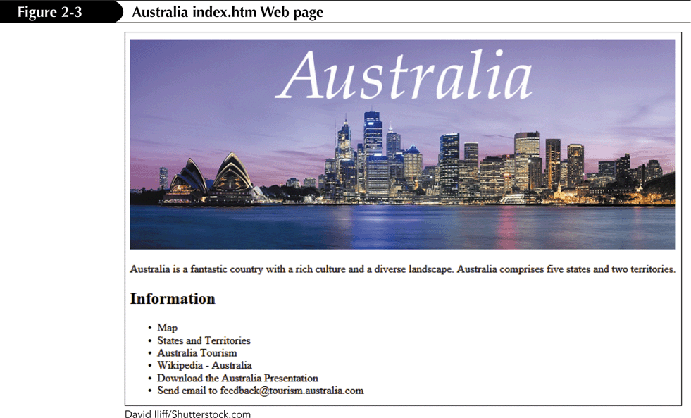
Hierarchy Chart Storyboard

Slide 10
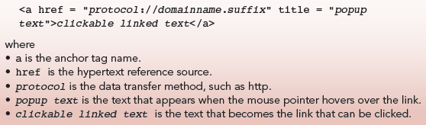
The Anchor Element
The anchor element is used to create a link.
The following code would create a link: <a href = "http://www.google.com/" title = "Google Search Engine"> Search Google</a>
Format for creating a link:

Slide 11
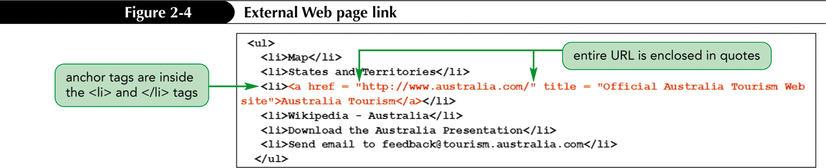
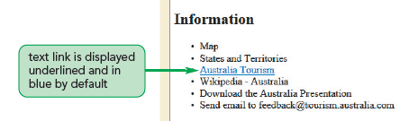
Linking to an External Web Page
To create a link to a page at a different Web site, you must include the complete URL of the Web page as the value for the href attribute.

Slide 12
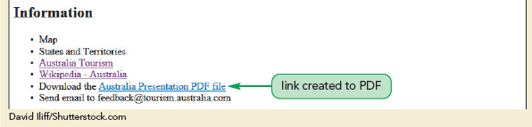
Linking to Non-HTML Files
The HTML code for a link to a file (PDF, for example) does not use the http:// protocol: <a href = "australia.pdf" title = "Australia Presentation">Australia Presentation PDF file</a>

Slide 13

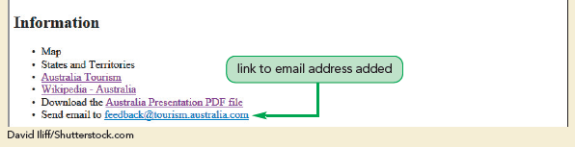
Creating an Email Link
An email link is created by using the mailto: protocol: <a href = "mailto:addressname@domainname.suffix"> linktext</a>

Slide 14
Creating a Link to a Specific Section
HTML5 has a new <section> tag used to identify content that belongs together as one section of information.
The id attribute is used to identify a section by assigning it a unique name.
Links to sections are known as anchor links or bookmark links.
Section: <section id = "idvalue"> content</section>
Link: <a href = "#idname">linktext</a>

Slide 15
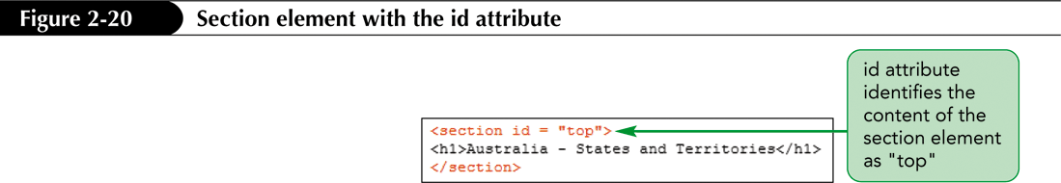
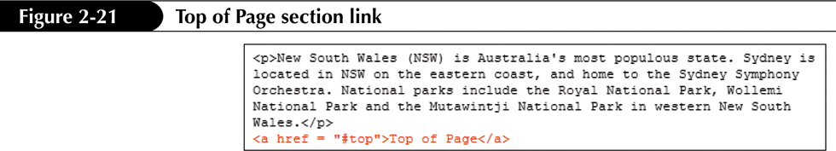
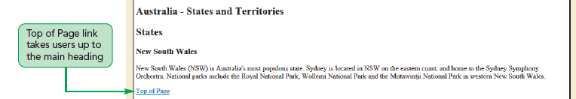
Creating a Link to a Specific Section

Slide 16
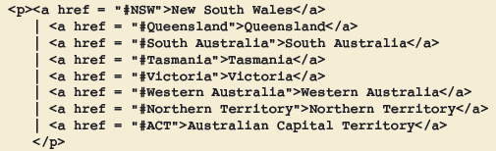

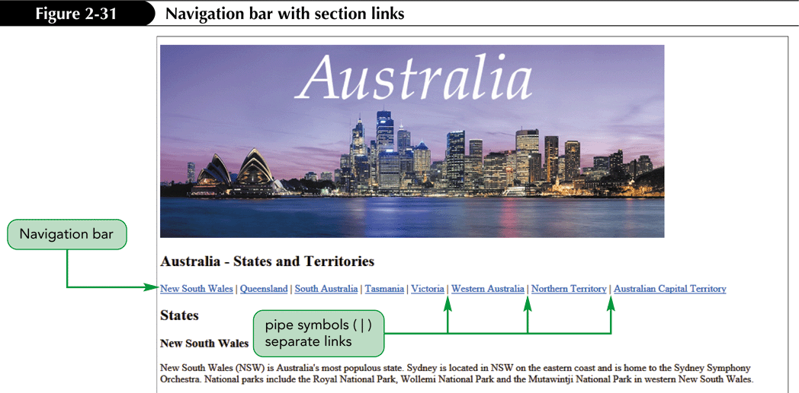
Creating a Navigation Menu

Slide 17
Linking to Another Web Page on the Same Site
Local link – points to a Web page on the same site
External link – points to a Web page on a different Web server
<a href = "filename">linktext</a>
<a href = "cities.htm">Cities Information</a>
<a href = "locations/cities.htm"> Cities Information</a>

Slide 18
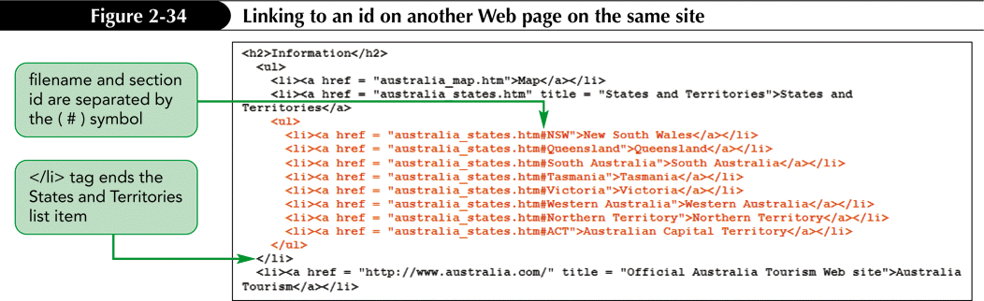
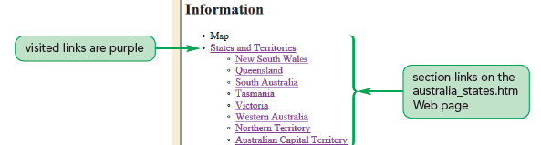
Linking to a Section on Another Web Page on the Same Site
<a href = "filename#section_id"> linktext</a>

Slide 19

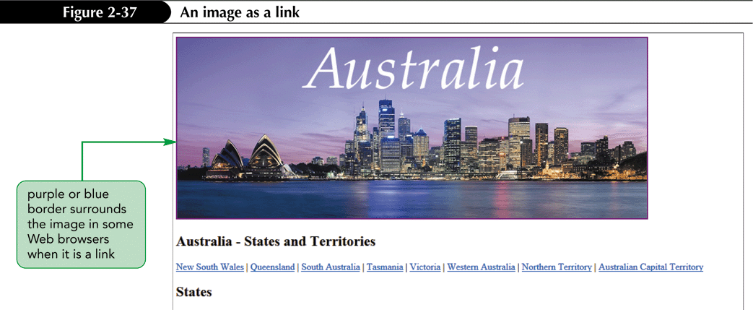
Using Images as Links
<a href = "filename"> <img src = "imagename" alt = "alternatetext" title = "titlevalue" width = "widthvalue" height = "heightvalue"></a>

Slide 20
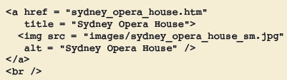
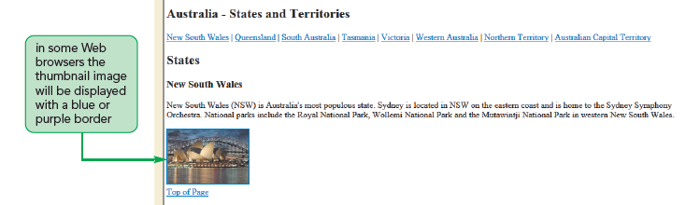
Thumbnail Links
A thumbnail image is a small image used as a link to another page that contains a larger instance of the same image.

Slide 21
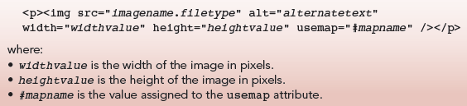
Creating Image Maps
An image map is an image that is divided into sections that serve as links.
The areas of the image that are designated to be used as links are called hotspots.
The usemap attribute and its value signal to browsers that an image is to be used as an image map.

Slide 22
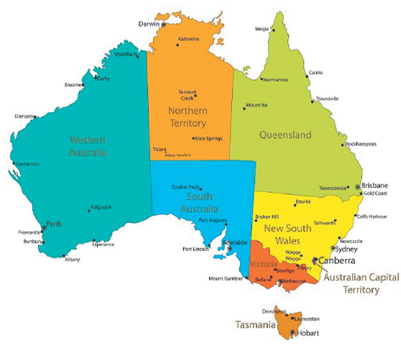
Image Used as Image Map

Slide 23
The map and area Elements
The map element contains all the code in an image map. <p> <map name="mapname"> <!--Tags defining hotspots will go here--> </map> </p>
The area element is used to create the hotspots that users click. <map name="mapname"> <area shape="areashape" coords="coordinates" href="reference" alt="alternatetext" title="titletext" /> </map>

Slide 24
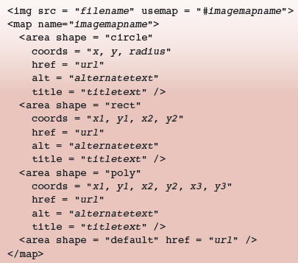
The shape Attribute
The shape attribute for area elements can take one of the following values:
circle (circle)
rect (rectangle)
poly (polygon)

Slide 25
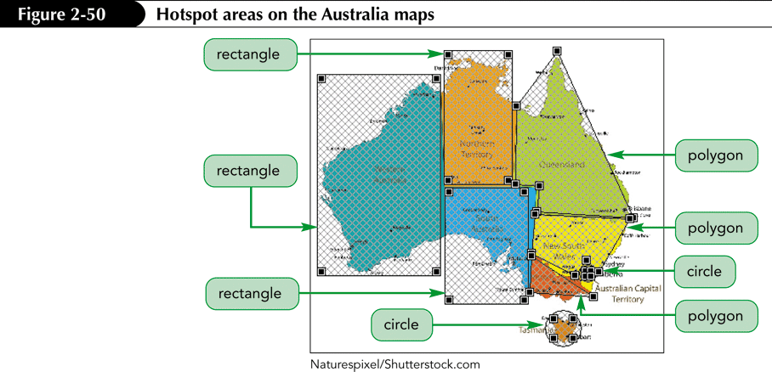
Hotspot Areas

Slide 26
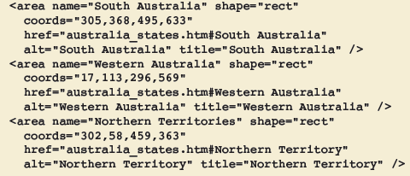
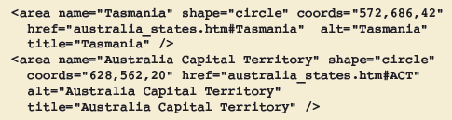
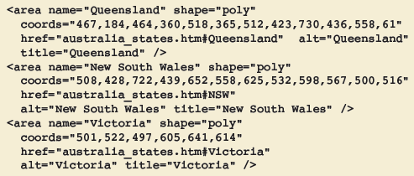
area Elements for Hotspots
shape = "rect"
shape = "circle"
shape = "poly"

Slide 27
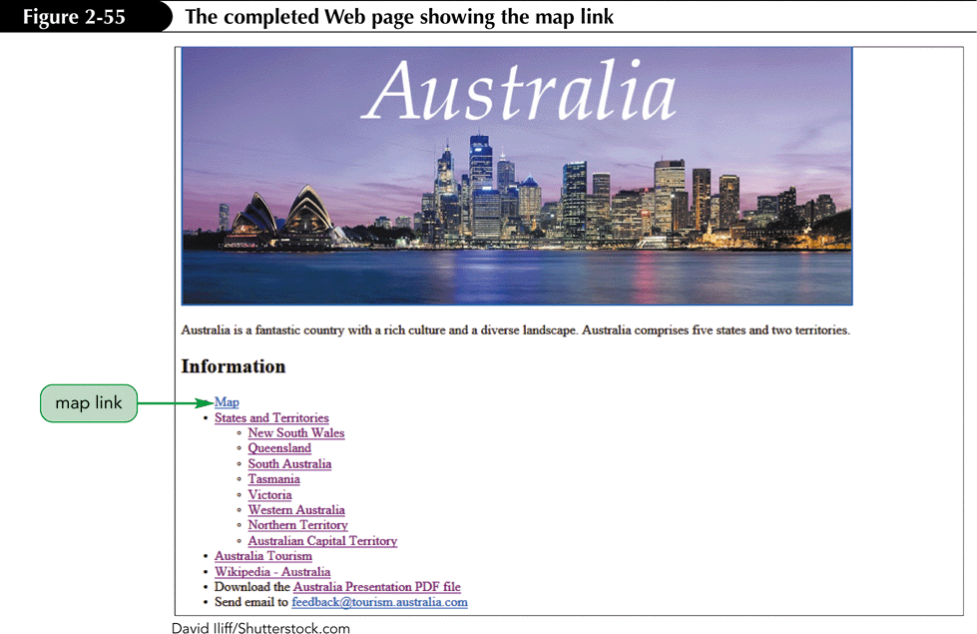
Map Link

